Slide 1
Classification and Regression Tress
Dr. Priyanka Shrivastava

Slide 2

Application
Credit Risk Assessment
Market Segmentation
(Mailing, Telemarketing)
Health Insurance underwriting
(Gives an understanding that why a health insurance plan was rejected)

Slide 3
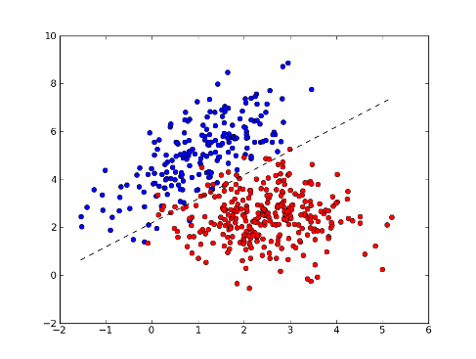
CART Analysis: The Logic
Find a line that separates the two classes and is equally distant from two class centers
Income
Age
Repeated splitting of predictors to get homogeneous classes

Slide 4

Example
Operating system preference
A mobile services company wants to build real time predictive model of operating system preference based on consumer demographics
Task: Classify preference of new phone buyers
Two classes, four predictors
100 records

Slide 5
Classification Tree
Age
42
29
31
Income
5k
Income
3k
6
23
4k
ios
15
16
ios
android
10
13
ios
android

Slide 6
Determining the splitting value
Best split = best separates records in different values
Examine all splits
Choose split that maximizes reduction in impurity nodes
Two impurity measures : Entropy and Gini Index
k
Entropy of a node = - ∑ p_{i} log₂ p_{i}
K= No. of Classes
P_{i =} the percentage of records in class i
i=1

Slide 7
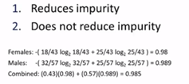
Entropy Computation
To compute reduction in impurity, compare entropy before and after the split
Entropy after split = weighted average of children’s entropy
Weight = size of child
Gender
43 F
57 M
25/ 18
25/32

Slide 8
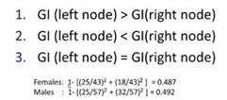
Gini-index computation
k
Impurity of a node GI = 1 - ∑ p_{i}²
K = No. of classes
Pi = the percentage of records in class I
i=1
Gender
43 F
57 M
25/ 18
25/32

Slide 9
Detecting good predictors
Predictors close to the top are more informative
Age
42
29
31
Income
5k
Income
3k
6
23
4k
ios
15
16
ios
android
10
13
ios
android

Slide 10
Converting tree into if-else-and statements
Age
42
If age is greater than 42 and income is greater than 5k then they will choose an ios
29
31
Income
5k
Income
3k
Each terminal nodes will have a statement
Can you predict preference of a lady with 50 years and 6 k income?
6
23
4k
ios
15
16
ios
android
10
13
ios
android

